Slide 1
AN INTRODUCTION TO PUBLISHING WITH SPRINGER NATURE
Lorraine Klimowich Senior Editor
04 June 2025

Slide 2
CONTENTS
Introduction
Book Publishing
Journals Publishing
Open Access
Conclusion/Questions

Slide 3
Introduction
1

Slide 4
INTRODUCTION
Established in 1842, Springer publishes over 2,900 journals and 300,000 books in English and German, across science, technology, medicine, humanities and business
Springer Nature was created in May 2015 through the combination of Nature Publishing Group, Macmillan Education and Springer Science+Business Media
We have more than 9,400 employees operating in 40+ countries worldwide
My remit includes all subdisciplines and book types in:
Economics
political science/IR
public administration
Notes:
Commercial publisher
Institutional library market
International

Slide 5
BOOK PUBLISHING
2

Slide 6
KEY BOOK SERIES
Notes:
Placing your work within a thematic series will boost your book’s visibility and impact. You are more likely to reach a targeted, engaged readership. Alongside related and influential books from the series, your book is part of a coherent body of knowledge, that contributes to your field of scholarship. Placing a book in a series helps to increase the discoverability of the book and also offers additional opportunities for promotion through conferences and marketing campaigns.

Slide 7
SELECTED TITLE HIGHLIGHTS
PY 2023 10k usage
24 citations
PY 2021 19K usage
7 citations
PY 2022 23K usage
7 citations
PY 2024 2500 usage
3 citations
PY 2022 1.16m usage
100 citations
PY 2023 10K usage
22 citations
PY 2021 11K usage
6 citations

Slide 8
HOW TO PUBLISH YOUR BOOK
Proposal
Contact Springer publishing editor (ME!) to discuss your idea and request proposal form
Proposal Peer Review
Publishing editor will send the proposal out for independent single-blind peer review
Depending on reviewer feedback, I will make recommendations (accept, R&R, reject)
Contract
Manuscript writing stage (decided in cooperation with author)
Full manuscript review
Revisions may be requested; may take more than one round
Production process & publication
Standard Springer production timeline is 5 months; varies according to complexity of project

Slide 9
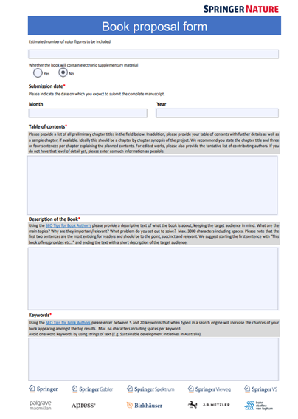
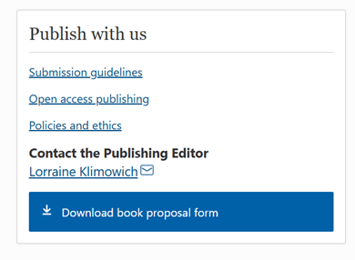
BEST PRACTICES FOR YOUR PROPOSAL
A complete proposal includes:
CV + list of publications
Description of the book (abstract)
Preliminary Table of Contents
Introduction + sample chapter(s)
Realistic list of related/competitive titles
List of 3-5 suggested arm’s length peer reviewers
For edited volumes: a list of chapter contributors, proposed chapters, and the method of peer review that the chapters will undergo
Please do NOT submit a proposal to more than one Springer Nature editor or imprint simultaneously!

Slide 10
JOURNAL PUBLISHING
3

Slide 11
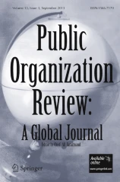
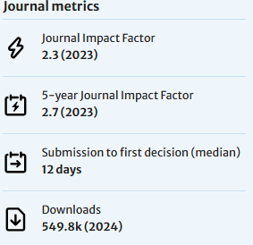
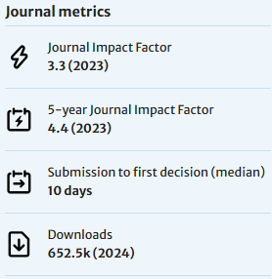
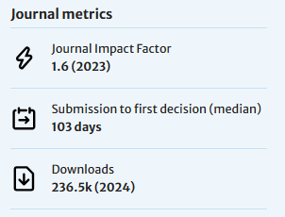
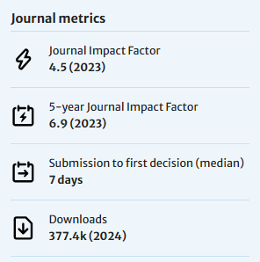
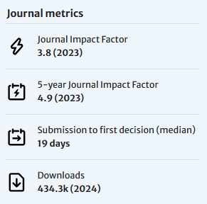
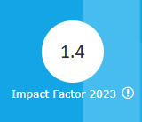
JOURNAL HIGHLIGHTS

Slide 12
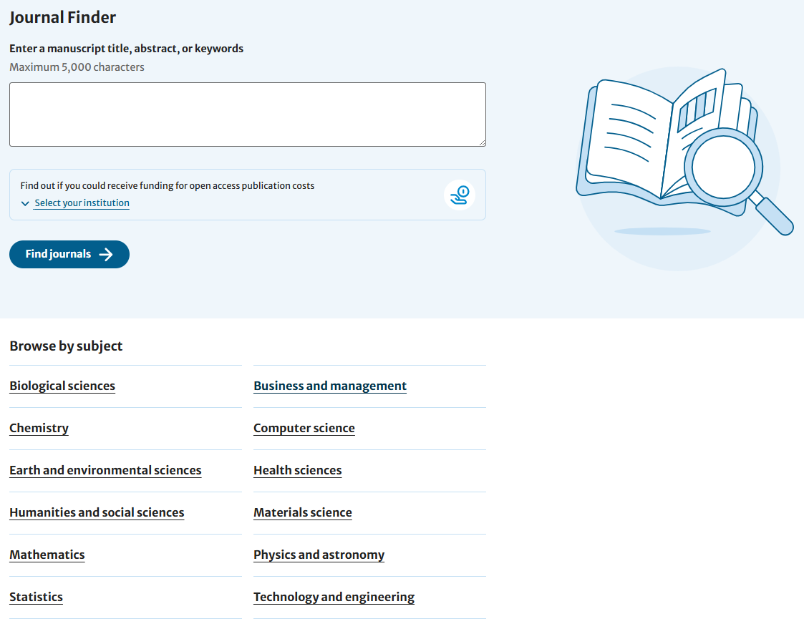
BEST PRACTICES FOR SUBMITTING
https://link.springer.com/journals

Slide 13
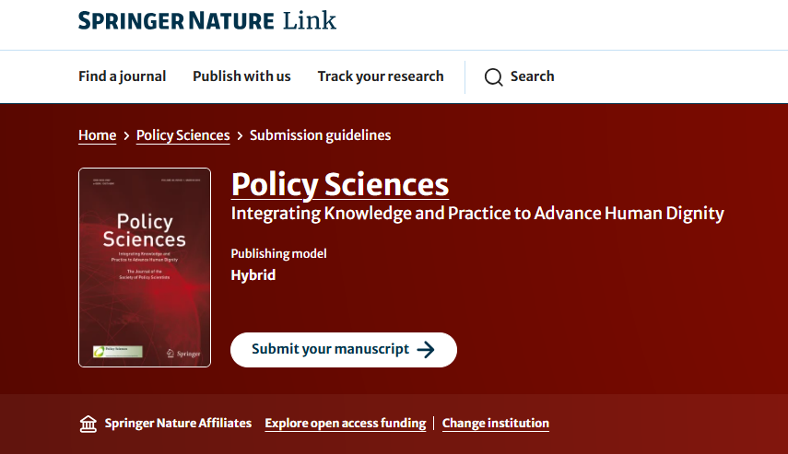
BEST PRACTICES FOR SUBMITTING

Slide 14
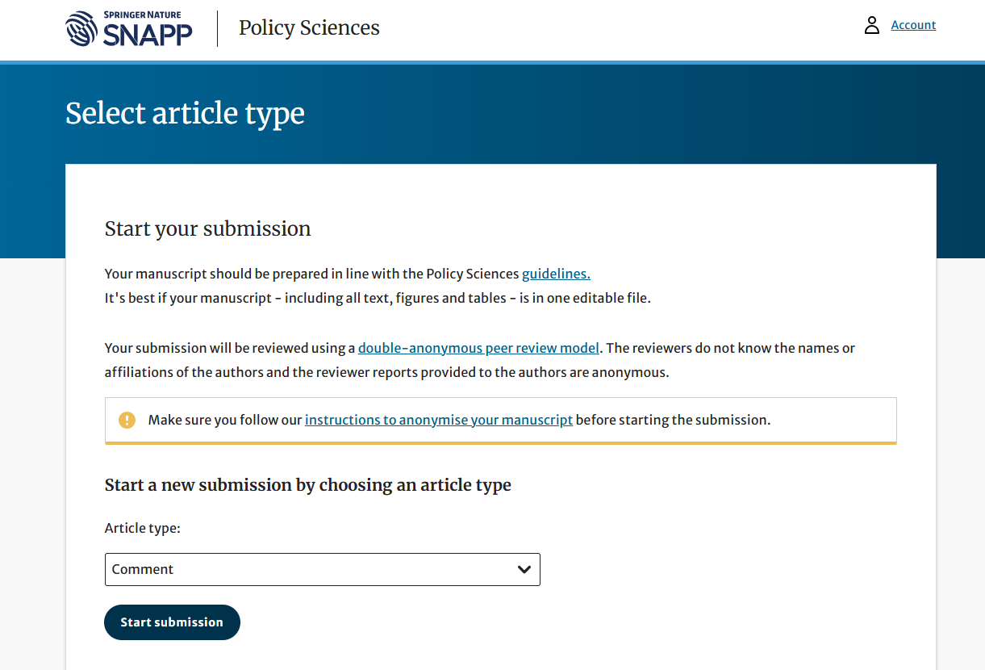
BEST PRACTICES FOR SUBMITTING

Slide 15
PREDATORY JOURNALS
Source: Evaluating Scholarly Journals Infographic by Allen Press via FrontMatter (CC BY ND NC 3.0)

Slide 16
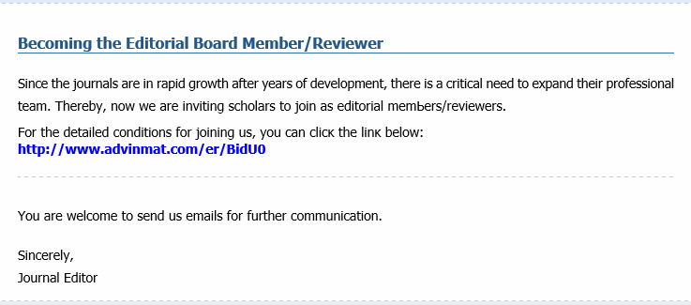
PREDATORY JOURNALS

Slide 17
OPEN ACCESS
4

Slide 18
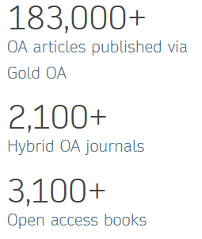
OPEN ACCESS PUBLISHING AT SPRINGER NATURE
Free, immediate, online availability of research outputs such as journal articles or books, combined with the rights to use these outputs fully in the digital environment
OA content is open to ALL, with no access fees
Authors can choose to publish their research as an article in a fully OA journal, a hybrid or transformative journal, or as an OA book or OA chapter by paying a fee up front (Gold OA)
Springer Nature allows authors to archive the accepted version of their manuscript on their own personal website or their funder’s or institution’s repository, for public release after an embargo period (Green OA)

Slide 19
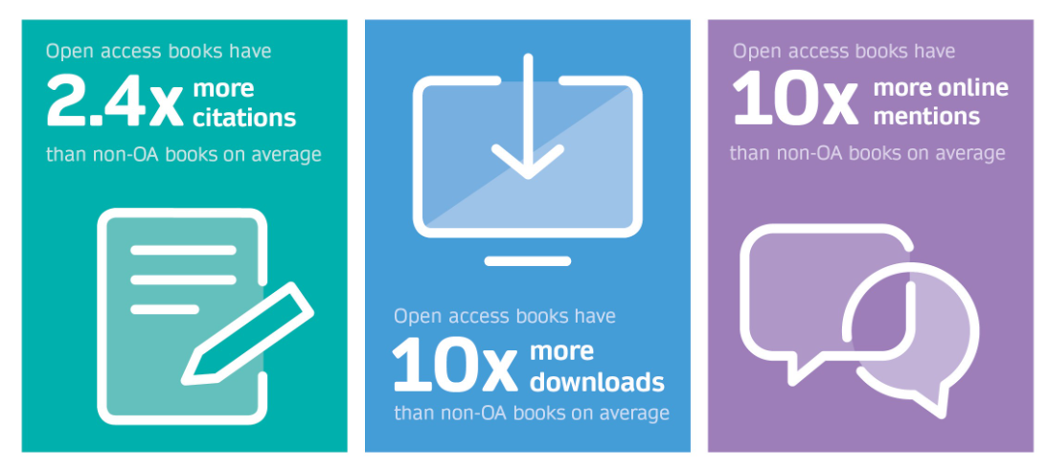
Advantages of OA Publishing
Increased citation and usage: Studies have shown that open access articles are viewed and cited more often than articles behind a paywall. | Faster impact: With Creative Commons licenses, researchers are empowered to build on existing research quickly.
Greater public engagement: Content is available to those who can't access subscription content. | Compliance with open access mandates: Open access journals and books comply with major funding policies internationally.
Increased interdisciplinary conversation: Open access publications that cross multiple disciplines help researchers connect more easily and provide greater visibility of their research.
Wider collaboration: Open access publications and data enable researchers to carry out collaborative research on a global scale.

Slide 20
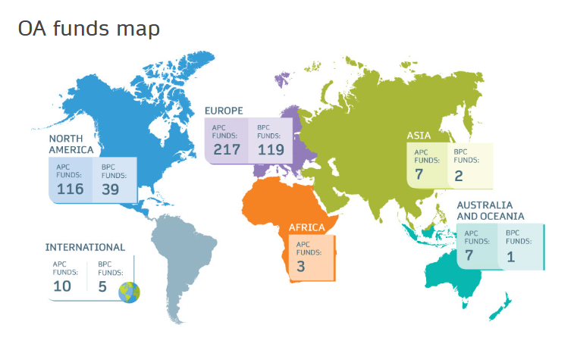
FUNDING SUPPORT SERVICES
Springer Nature offers a free support service to make it easier for our authors to discover and apply for funding to cover APCs and BPCs:
springernature.com/gp/open-science/funding
Provide information on OA funds that may be available to you
Direct you to the open access funding coordinator at your institution
Supply you with information required to complete funding applications
Offer personalized advice about the application process for your institution or funding body
Provide advice about compliance with funders' and institutions' OA policies
For specific questions, email: OAfundingpolicy@springernature.com

Slide 21
THANK YOU
Please email with any questions!
Lorraine Klimowich
Lorraine.Klimowich@springer.com

